Slide 1










Team:-
IRONY
Abhay Saini
GROUP LEADER
GU Mail I’d : abhay.24sece1290084@galgotiasuniversity.ac.in
ADMISSION NO. : 24SECE1290084
Introducing Our Team
Kunal
GROUP MEMBER
GU Mail I’d : Kunal.24sece1290082@galgotiasuniversity.ac.in
ADMISSION NO. : 24sece1290082
Nikhil Yadav
GROUP MEMBER
GU Mail I’d : Nikhil.24sece1290173@galgotiasuniversity.ac.in
ADMISSION NO. : 24SECE1290173
Yash Garg
GROUP MEMBER
GU Mail I’d : yash.24sece1290085@galgotiasuniversity.ac.in
ADMISSION NO. : 24SECE1290085

Slide 2
Library Management System
A Java Console Application for Effective Library Management

Slide 3

Introduction
The Library Management System is a Java console application that helps manage book issuing, returns, and member registration. It uses object-oriented programming and organizes books by genre (Fiction, Non-Fiction, Others). Designed with in-memory storage, it’s best suited for small libraries or academic use, and provides a solid base for future upgrades like database integration or a GUI.

Slide 4
Introduction to the Library Management System
The Library Management System is designed to automate essential functions of a library. It enables efficient management of books, members, and transactions, ensuring that issuing and returning processes are streamlined.

Slide 5

Core functionalities
This system supports operations such as book issuing, returning, and member registration. Users can interact with the system through a console interface, making it accessible and easy to navigate.

Slide 6
Categorization of books
Books are categorized into three main genres: Fiction, Non-Fiction, and Others. This classification aids in organization and retrieval, enhancing user experience when searching for books.

Slide 7
Book management
The system allows librarians to add books, track their availability, and manage their categorization seamlessly. Automatic availability tracking ensures users are informed about book status.

Slide 8
Member management
New members can be registered quickly, with their details stored for tracking borrowings and returns. This feature enhances interaction between the library and its users.

Slide 9

Issuing and returning books
The software enables easy issuance and return of books, complete with automated receipt generation. This ensures clarity and accountability in all transactions.

Slide 10
Programming language details
The Library Management System is developed in Java, a versatile programming language that supports object-oriented principles. Java's portability across platforms allows the system to be used in various environments without modification.

Slide 11
Development environment
The development of this application can be facilitated using Integrated Development Environments (IDEs) such as IntelliJ IDEA or Eclipse. These tools provide a user-friendly interface for writing, debugging, and managing Java code effectively.

Slide 12
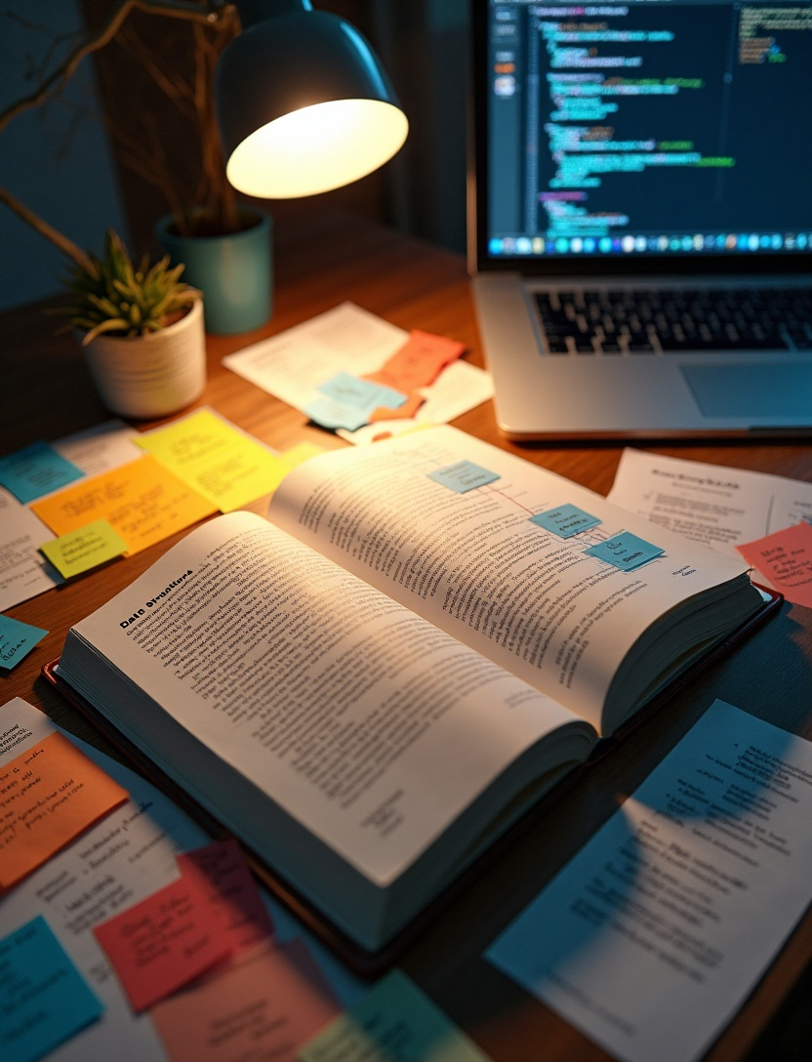
Data structures utilized
ArrayLists are utilized for dynamic storage of books, members, and transactions. This choice allows for easy addition and removal of elements, which is essential in managing changing data within the library system.

Slide 13

Overview of classes
The system is structured around several core classes: Book, Fiction, NonFiction, Other, Member, Issuing, Return, and LibraryManagementSystem. Each class serves a specific purpose in organizing the overall functionality of the application.

Slide 14
Class relationships
Classes such as Fiction, NonFiction, and Other extend the abstract Book class, inheriting its properties and methods. This structure promotes code reusability and adheres to object-oriented design principles.

Slide 15
Abstract class design
The abstract class Book defines fundamental attributes and methods shared by all book types. This abstraction allows specific genres to implement the common functionality while maintaining unique characteristics.

Slide 16
Prerequisites for running the system
To execute the Library Management System, users must have JDK 8 or above installed on their machines. Additionally, a compatible IDE or command-line tools are necessary to compile and run the Java program.

Slide 17
Compilation and execution steps
Users must save the source code in a file named Main.java. The program can then be compiled using the command 'javac Main.java', followed by executing the compiled program with 'java Main' to start the application.

Slide 18
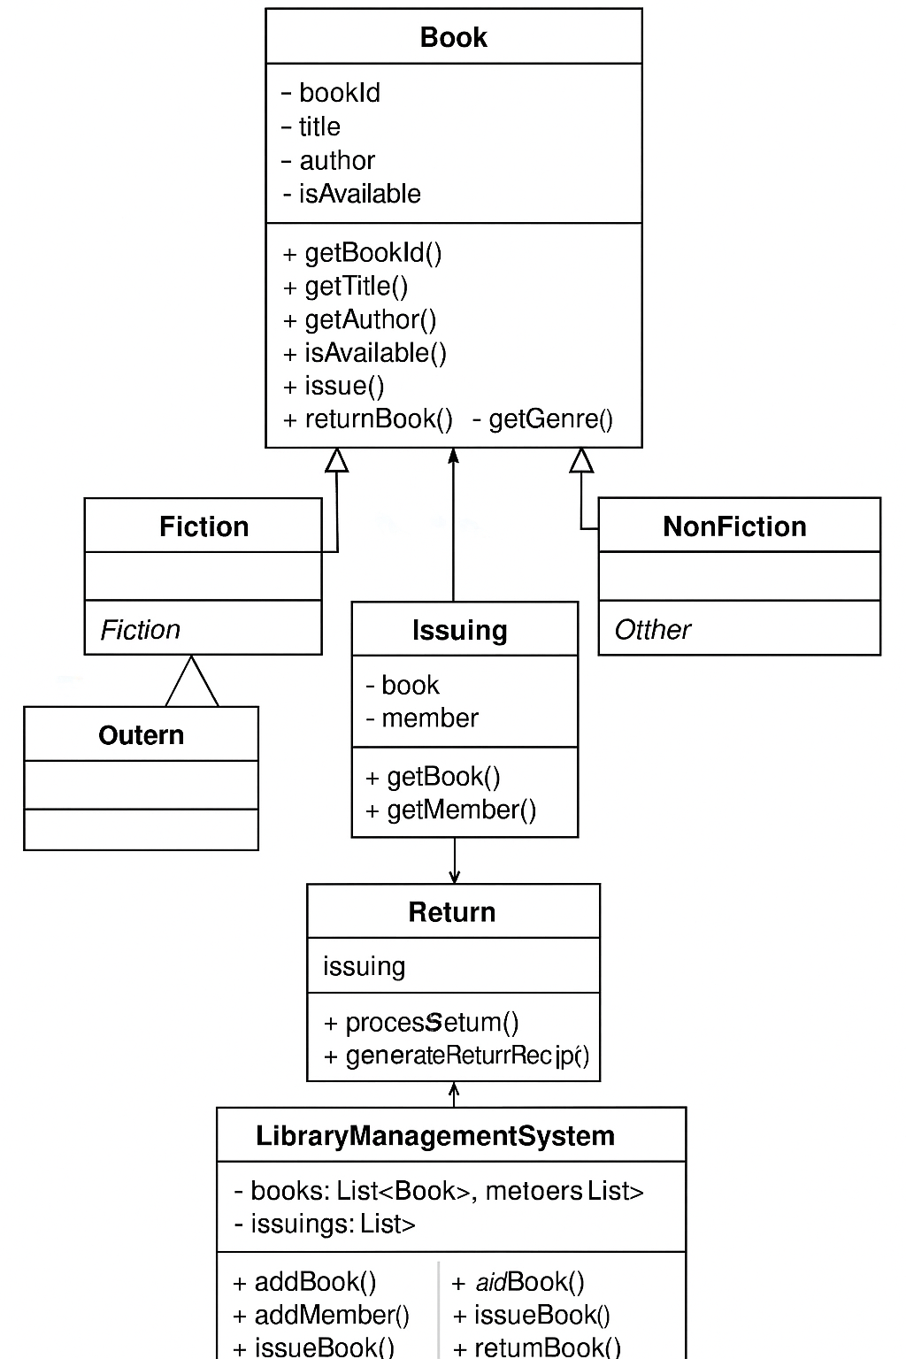
Class Diagram

Slide 19
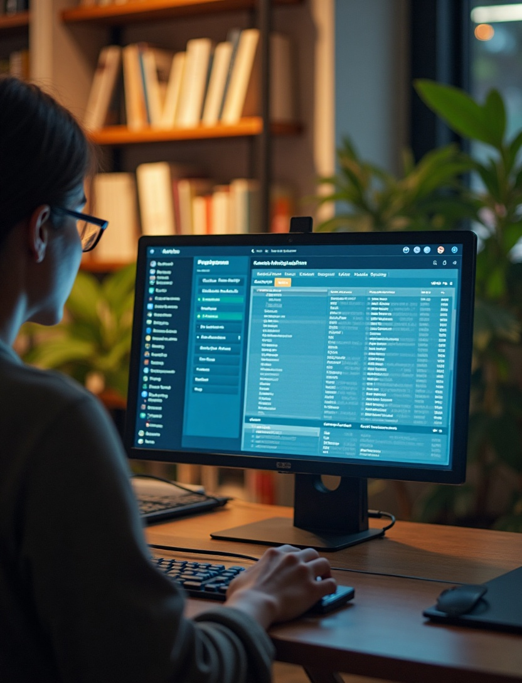
User interaction through menu
The application provides a simple console-based menu that guides users through various functions such as issuing books, returning books, and managing members. This intuitive interface enhances user engagement with the system.

Slide 20
GitHub Repository Overview
Link : https://github.com/Abhay-0060
Public with :
Full source code
README
Database script
Presentation PPT

Slide 21

Conclusions
The Library Management System provides a robust framework for efficiently managing library operations. With its Java foundation and object-oriented design, it offers a scalable solution adaptable for future enhancements, including GUI integration.

